Slide 1
Consumers and Decomposers

Slide 2
In this Smart Lesson, we will focus on consumers and decomposers. By the end of the lesson, you should be able to:
1. | Describe what a consumer is.
2. | Define the terms herbivore, carnivore and omnivore.
3. | Describe the different levels of consumers.
4. | Explain what a decomposer is.

Slide 3
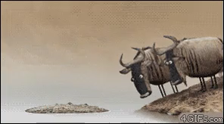
Consumers gain energy by eating other organisms.
Consumers need to eat other organisms to survive.

Slide 4
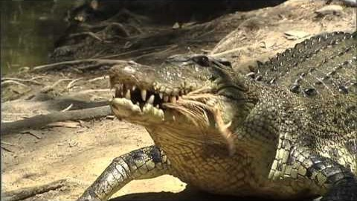

Slide 5
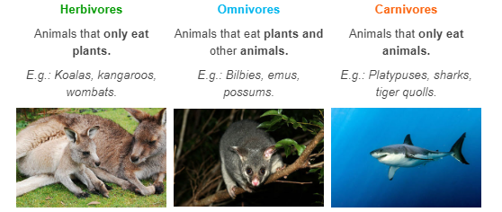
Consumers can be broken up into three groups:

Slide 6
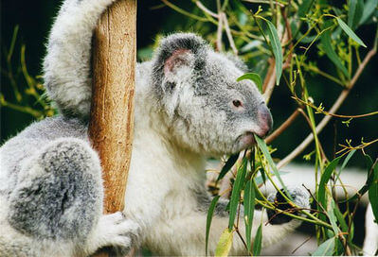
Consumers can be broken down to different levels.
Herbivores, animals that feed directly on producers, are called first order consumers.
A koala is an example of a first order consumer, since it mainly eats eucalyptus leaves.

Slide 7
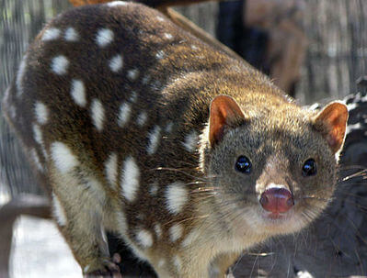
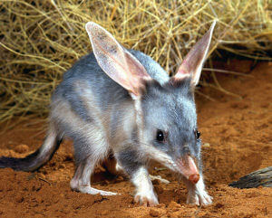
Animals that consume herbivores are second order consumers.
Second order consumers can be either carnivores, because they just eat first order consumers, or omnivores, because they eat first order consumers and plants.
For example, tiger quolls are carnivorous second order consumers because they only eat other animals. Bilbies are omnivorous second order consumers, because they eat insects and plants.

Slide 8

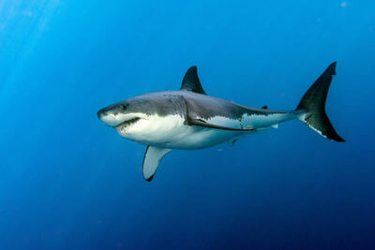
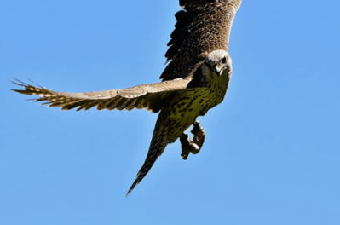
Third order consumers eat lower order consumers and are sometimes called final consumers.
Examples of third order consumers include humans, sharks and raptors.

Slide 9
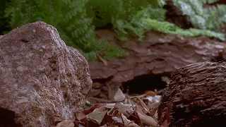
Decomposers are organisms that gain energy by breaking down dead or decaying organisms.
Some of the most common decomposers are worms, slugs, snails and fungi like mushrooms.
As they break down dead or decaying organisms, decomposers return nutrients to the soil. These nutrients can be used by producers to grow!
Fungi are especially good at returning nutrients to the soil

Slide 10
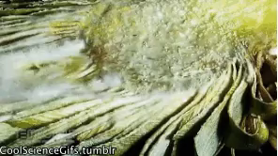
Microorganisms play a special role in decomposition.
Microorganisms include all organisms too small to be seen with the naked eye. They can be found almost anywhere on Earth! Even though we can't see them, they have a huge impact on us and the environment!
Bacteria and fungi are an example of microorganisms.

Slide 11
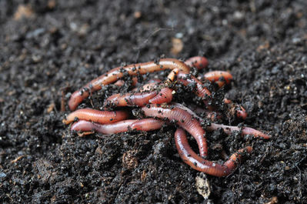
Another thing organisms do is excrete.
They generate waste that builds up in the soil.
Organisms that eat this waste to get energy are called detritivores. The waste itself is known as detritus to a biologist. Many burrowing animals, such as earthworms and other annelids, are detritivores.

